Slide 1

Data Science 101 Course 2
Ratio1. Decentralized Data Science & MLOps
Politehnica University of Bucharest
Faculty of Automatic Control and Computer Science
Professor: Andrei Ionut DAMIAN Assistent: Vitalii Toderian
03-ACS-M-A1-A2-S1
Notes:
AI today is too centralized and costly.
Ratio1 meta-OS makes it easier and cheaper by using a decentralized,
low-code system. In this talk, we’ll show how it works and where it’s used

Slide 2
Quick overview
Introduction & Problem context
Motivation & Goals
Related Work
Ratio1 Meta OS Core Concepts
Enhanced Oracle Synchronization
Practical Applications
Aiho - property management app
Demo
Q&A

Slide 3
Introduction & Problem Context
"Ubiquitous Computing" integrates computational capabilities into everyday life
Centralized Challenges
• High infrastructure costs
• Centralized dependency
• Complex workflows
• Specialized expertise requirements
• Billions of devices idle with compute capacity
Notes:
Ubiquitous computing aims to bring smart tech everywhere, but in practice,
running modern AI still depends on sending data to big cloud providers.
That increases Operating Expenses, creates compliance headaches, and leaves Small and Medium-sized Enterprises out in the cold.
Energy use is skyrocketing.
Very big infrastructure costs, coupled with complex MLOps procedures
and the need for high specialized expertise, mean AI application development remains far from democratized.

Slide 4
Introduction & Problem Context
"Ubiquitous Computing" integrates computational capabilities into everyday life
Centralized Challenges
• High infrastructure costs
• Centralized dependency
• Complex workflows
• Specialized expertise requirements
Decentralized Benefits
• Reduced costs
• Distributed reliability
• Simplified deployment
• Democratic access
Notes:
So, we asked: can we invert that dependency and treat the global edge itself as the cloud?
Ratio1 AI meta-OS is built to fix this challenge.
Its vision is to democratize AI by transforming everyday computing devices into income-generating assets for decentralized AI workloads.
This approach reduces costs and makes advanced AI affordable and accessible, especially for startups, independent developers, and underserved communities

Slide 5
Motivation and Research Goals
🌐
Democratize AI Access & Data control
Make AI technologies accessible to everyone, not just large corporations. Only you have access to your data!
🔧
Sustainable Ecosystem
Develop decentralized, economically efficient AI infrastructure
⚡
Easy Deployment & Deployment
Enable deployment via low-code/no-code platforms
🪙
Economic fairness
Tokenized rewards, no central rent
Notes:
"So, what's driving Ratiol? We're focused on four main goals:
First, Democratizing AI & Data Control. Our aim is to make AI technology accessible to everyone, not just large corporations.
A big part of this is ensuring you have control over your own data, which we support through privacy-enhancing technologies.
Second, building a Sustainable Ecosystem. We plan to do this by creating a decentralized and economically efficient AI infrastructure.
This involves making better use of existing compute resources worldwide.
Third, ensuring Easy AI Deployment and Development. We're lowering the barriers by offering low-code development and deployment frameworks. This means simpler tools and templates to help more people build and use AI.
And fourth, establishing Economic Fairness. We're using a token-based model to reward those who contribute their compute resources. This creates a fair system where participants can collaborate without relying on traditional, centralized cloud providers.
These four goals are the heart of Ratiol. Everything we're developing is designed to achieve this vision of a more open, efficient, and fair AI landscape.

Slide 6
Background - decentralization & Web 3.0
Web 1.0
Read-Only
Static Content
Web 2.0
Interactive
User-Generated
Web 3.0
Decentralized
Blockchain-Based
Peer-to-Peer
Web 3.0 enables transparent, equitable digital ecosystems through blockchain technology
Notes:
Here we can see the web evolution.
Web 3.0 uses decentralized blockchain technology to bring more transparency and trust.
For Ratiol, this means we anchor key operational rules, licensing, and activity logs on-chain using smart contracts.
This makes them transparent and immutable.
However, for speed and efficiency, AI computation and heavy data work remain off-chain.
This hybrid approach is what allows Ratiol to be a fast, secure, and trust-minimized platform.

Slide 7
Related Work Overview
Approach | Centralized Cloud (GCP, AWS) | Decentralized Compute (Golem, iExec) | Agent-Based AI (SingularityNET) | Ratio 1 Meta-OS
Cost | High | Moderate | Variable | Low
Security | Good | Variable | Good | Excellent
Complexity | High | Medium | High | Low (low-code)
Notes:
AWS, GCP excel at scale but remain centralised and expensive.
Golem, iExec tokenise surplus compute but stop at VM orchestration.
SingularityNET offers AI agents yet doesn’t solve low-code deployment.
Ratio1 fills that gap: a full MLOps stack, low-code, privacy-preserving, running on a decentralised network.

Slide 8
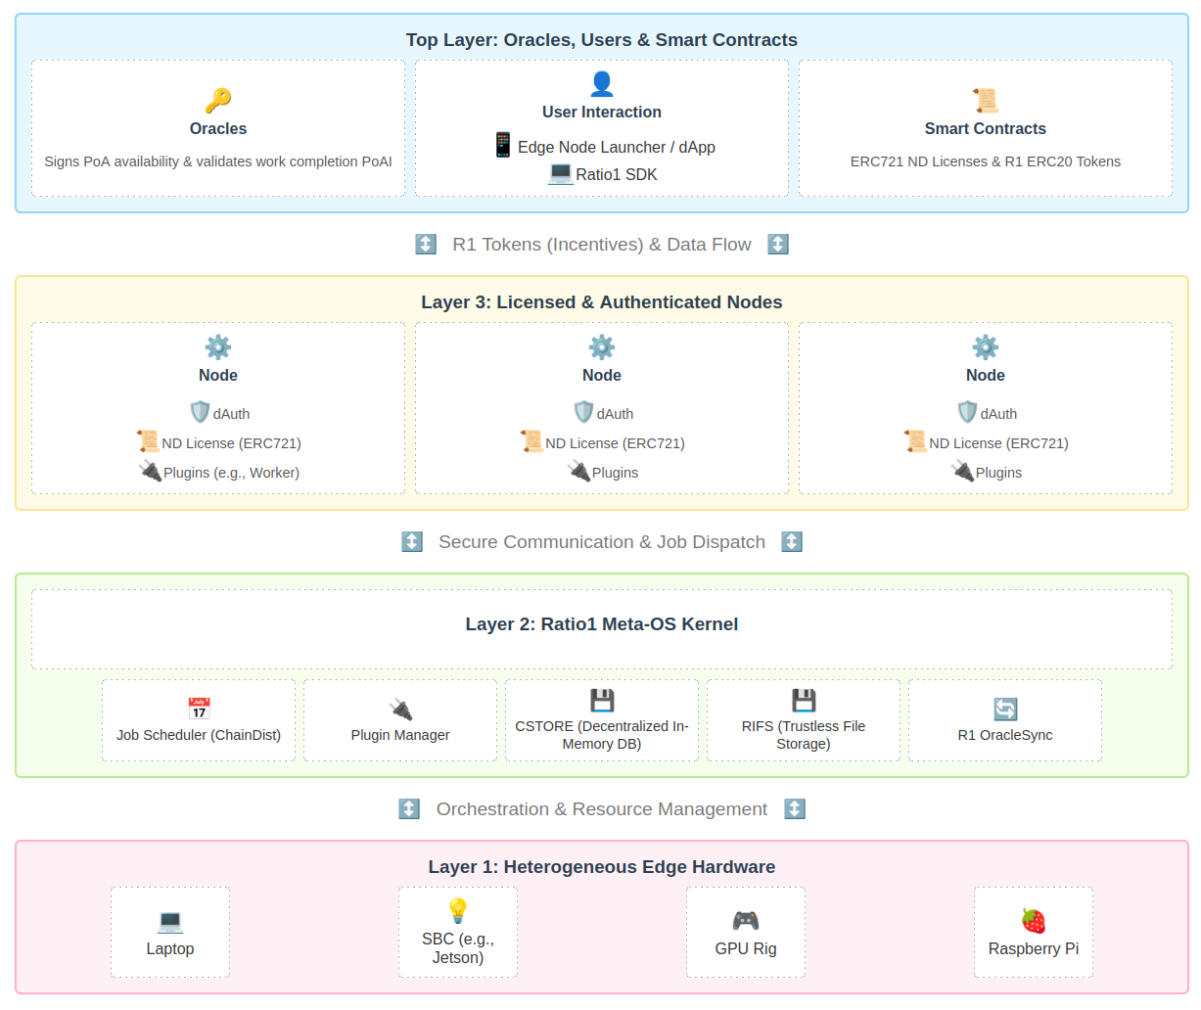
Ratio1 Meta-OS - Core Concepts
Decentralized operating system for Machine Learning Operations (MLOps)
Notes:
"This slide shows the main ideas – the core concepts – behind how Ratio1 Meta-OS is built. Think of it as looking at the different layers that work together:
First, at the bottom, Layer 1 is all about the Hardware.
Ratiol can use all sorts of everyday computers: from your laptop or a small Raspberry Pi to powerful GPU setups. These devices together power the network.
Next up is Layer 2, the Ratio1 Meta-OS Kernel – think of it as the system's brain. This layer manages and coordinates everything.
It includes our Job Scheduler (ChainDist) to decide who does what work.
It has smart storage: RIFS for securely sharing big files, and CSTORE for quick data access between nodes, like a shared super-fast memory.
R1 OracleSync is also here, helping to monitor and keep everything running smoothly and securely.
Then we have Layer 3, the Licensed and Authenticated Nodes – these are the 'workers' of the network. These are the computers actually doing the AI tasks.
To join, each node needs an ND License, which is a special NFT, like a digital ID card.
Our dAuth system checks this ID on the blockchain to make sure only trusted and licensed nodes can connect and work.
And at the Top Layer, we have Oracles, Users, and Smart Contracts – this is where control, interaction, and rules live.
Oracles act like trusted verifiers, confirming nodes are working and results are correct.
Users can easily build applications using our simple Ratio1 SDK (a developer toolkit) or manage their nodes with the Edge Node Launcher app.
Smart Contracts are the digital rulebooks, managing things like the node licenses (ND ERC721) and the R1 tokens (ERC20) used for payments and rewards.
So, what makes Ratiol special?
It’s how all these layers work together seamlessly in a decentralized way, without needing a central company in charge.
This creates a truly peer-powered system for AI that's more open, cost-effective, and secure than traditional cloud platforms."

Slide 9
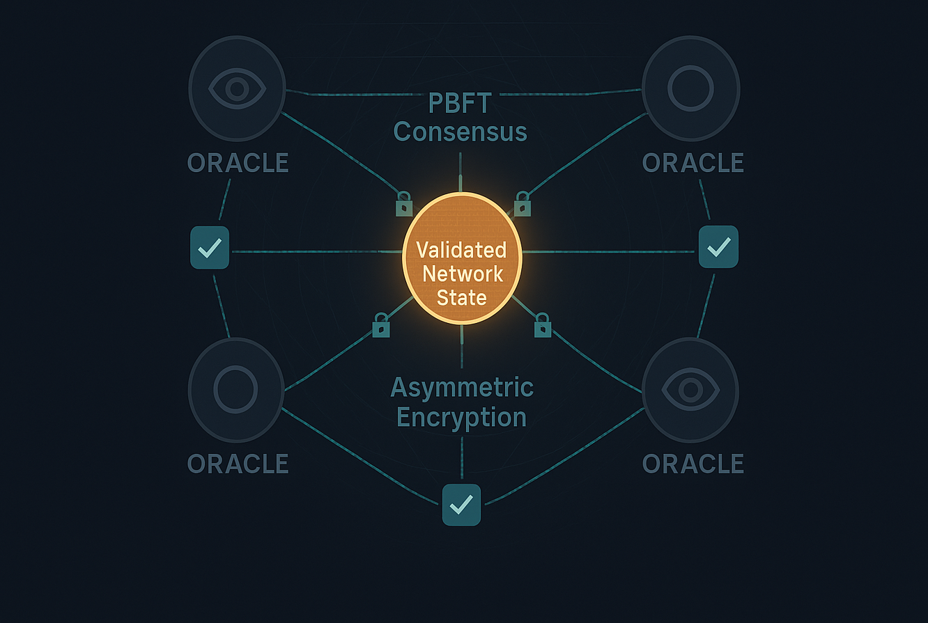
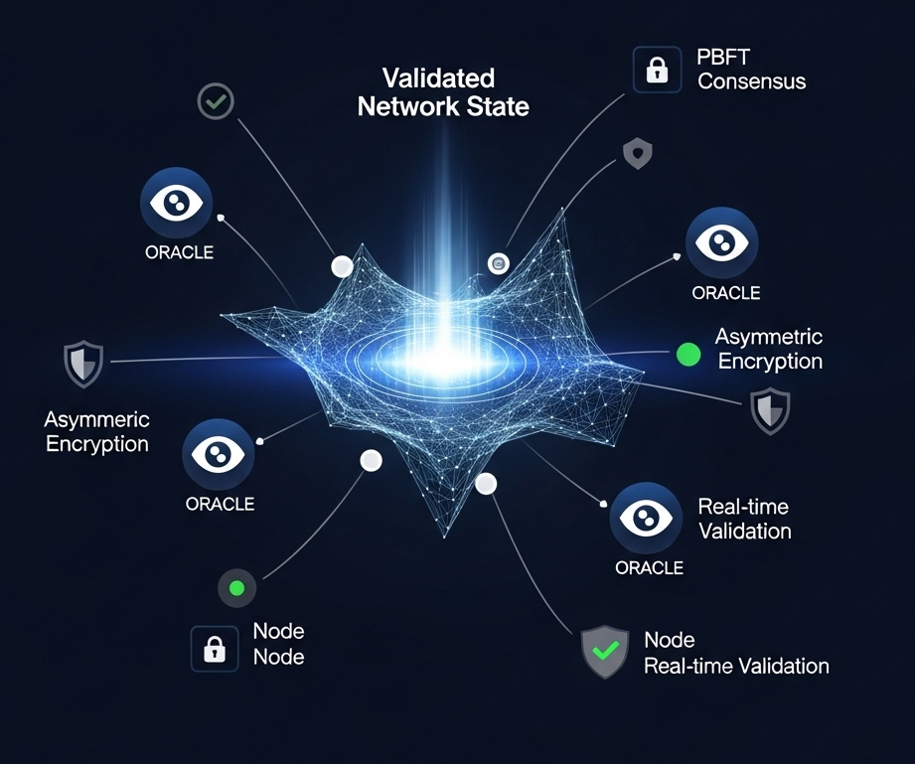
Enhanced Oracle Synchronization
PBFT Consensus: Practical Byzantine Fault Tolerance
Asymmetric Encryption: Secure oracle-node communication
Real-time Validation: Continuous node reliability checks
PBFT ensures fault tolerance and security in trustless environments
Notes:
With Enhanced Oracle Synchronization we ensure trust and reliability across our decentralized network.
At the core is a dedicated oracle synchronization mechanism, which is part of the Ratiol Oracle Network and its component R1 OracleSync. This system is responsible for preparing and committing node-monitoring data within a trust-minimized environment.
To achieve this robust synchronization, we utilize the key technologies highlighted:
PBFT Consensus (Practical Byzantine Fault Tolerance): We use an adapted PBFT method that allows our distributed oracle nodes to achieve reliable agreement, or consensus, on network information.
Asymmetric Encryption: This is tightly integrated with PBFT to ensure secure communication between oracles and nodes. 'one-to-many asymmetric encryption' approach, which protects the data being exchanged without complicating scalability or performance.
Real-time Validation: The combination of PBFT and asymmetric encryption enables near real-time verification of node status and reliability. This means we have continuous checks on whether nodes are online, operational, and behaving as expected.
This setup ensures the immutability of the consensus records – once data is validated and agreed upon by the oracles, it cannot be altered, which is fundamental for a trustless system.
This entire oracle synchronization process, with its secure, two-way communication, reinforces the trustless ethos central to the Ratiol ecosystem and safeguards it against malicious attacks or data tampering."

Slide 10
Decentralised Storage
R1FS – IPFS-compatible, chunk-level proofs
CSTORE – Redis-like, replicated key-value
📁
R1FS
Decentralized file storage (IPFS-inspired)
Immutable & Secure
💾
CSTORE
In-memory decentralized database & storage
Redis alternative
Notes:
Our approach to data and access in Ratiol is fully decentralized and trustless:
Flexible Data Storage:
For data that needs to remain unchanged, like important records or artifacts, we use RIFS (Ratiol File System).
This provides secure, immutable, and distributed file storage.
For dynamic data that needs quick access and updates, like application states, we use CSTORE. Think of it as a decentralized in-memory database, similar to Redis, designed for peer-to-peer sharing and eliminating single points of failure.

Slide 11
dAuth
🔐
dAuth
Blockchain-based authentication
Node verification
No central Auth,
Notes:
Trustless Authentication with dAuth:
Access to the network and its resources is controlled by dAuth, our decentralized authentication microservice.
dAuth verifies a node's legitimacy by checking its on-chain ND License (an ERC721 NFT). This ensures only nodes holding a valid, unexpired license can join and participate.

Slide 12
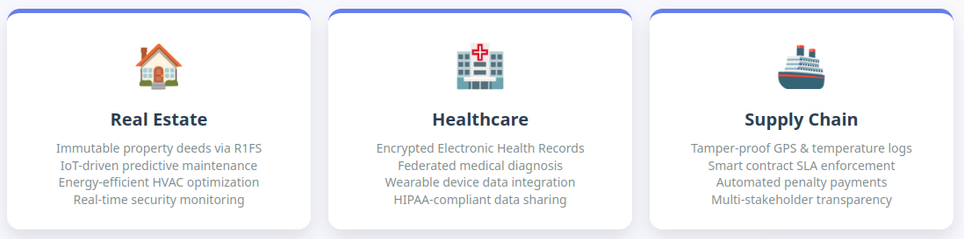
Practical Implementation & Application
Notes:
First, in real estate, we use our decentralized file system to store important documents like deeds and contracts securely.
It also allows for real-time monitoring of building conditions, enabling predictive maintenance and energy optimization.
Second, in healthcare, Ratio1 provides a secure way to manage sensitive medical records and diagnostics.
With predictive analytics, we support early diagnosis and personalized care, and integrate data from wearables, which is vital for modern health monitoring.
Third, in supply chains, we bring transparency and automation.
From tamper-proof temperature or location logs to smart contract enforcement, Ratio1 ensures traceable, real-time logistics while enabling secure access for all stakeholders.

Slide 13

Notes:
"Aiho is a decentralized platform that transforms how we manage and interact with real estate. For homeowners, it creates a secure digital twin of their apartment as an NFT, where documents and smart modules like air quality or intrusion detection are managed in one place—privately and modularly. For builders, Aiho is a revenue-generating marketplace where they can publish modules that work across all EVM-compatible chains, and deploy them without DevOps overhead thanks to Ratio1's decentralized infrastructure. Real estate developers benefit by tokenizing and timestamping all buyer-facing documents, enabling post-sale subscriptions, proving sale uniqueness, and preventing fraud—all through a blockchain-secured chain of trust from day one."

Slide 14
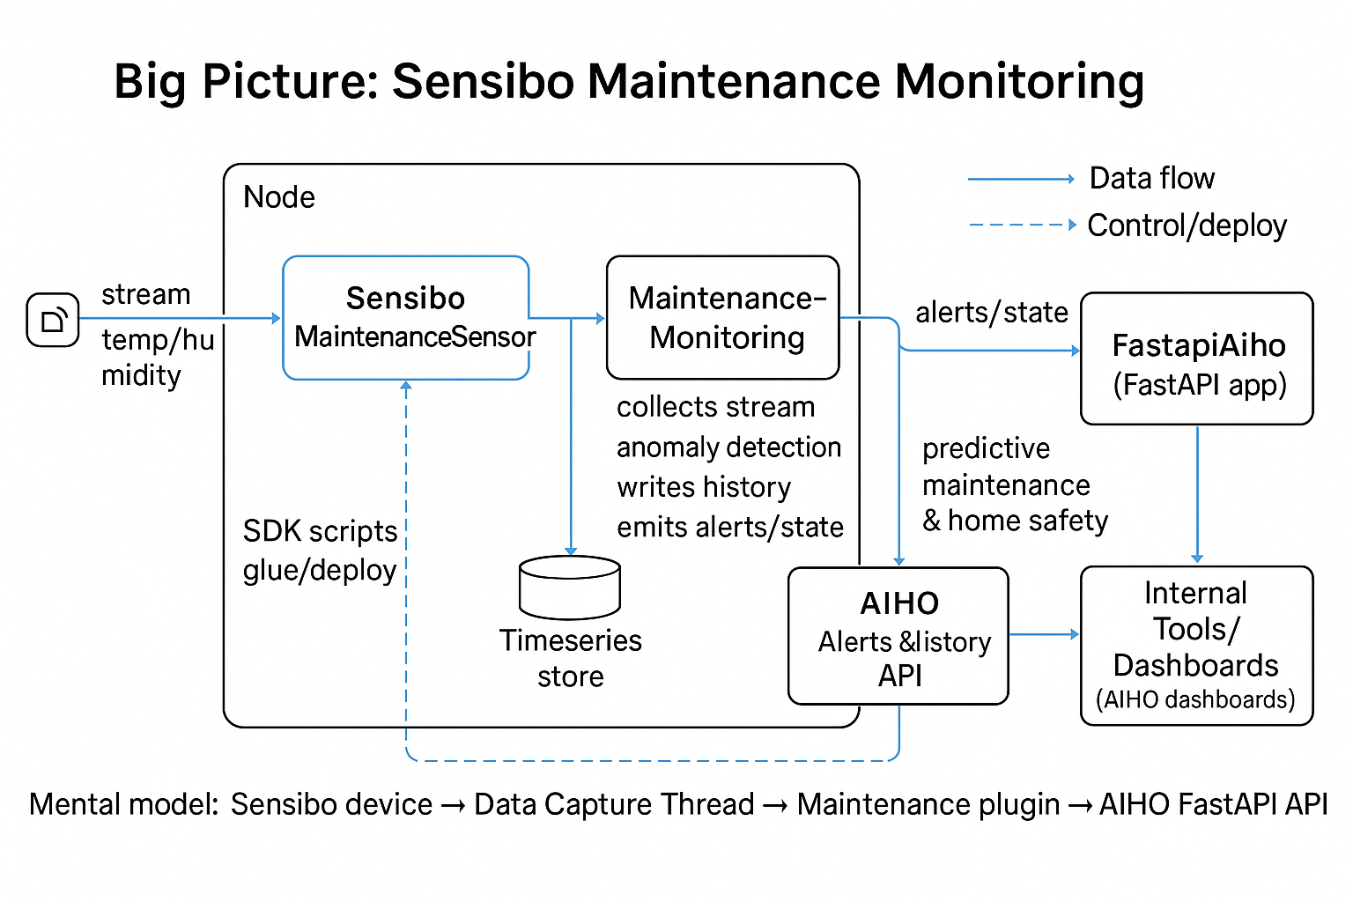

Slide 15
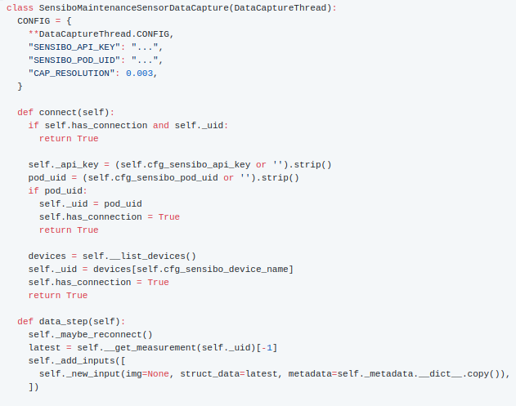
Getting data from Sensibo
The data capture thread (DCT) handles all communication with Sensibo. It validates secrets, reconnects when needed, and packages each reading for the rest of the pipeline.
Why it matters: every other component assumes this class keeps delivering fresh sensor data with tidy metadata.

Slide 16
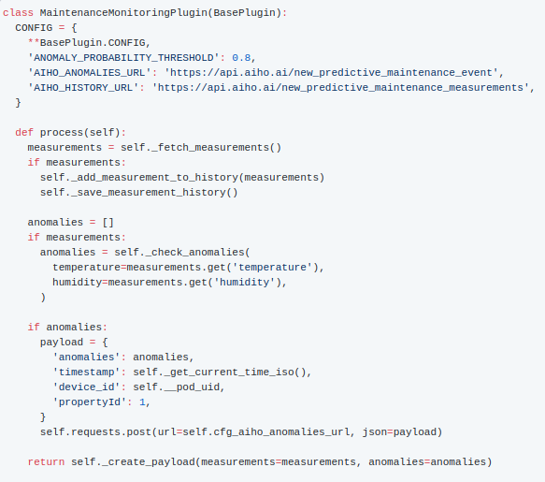
Turning Sensor Data Into Insights (Business Plugin)
The maintenance plugin gathers data points, runs anomaly detection, and talks to AIHO. Most of the heavy lifting happens inside process().
What happens: as soon as humidity or temperature drifts, the plugin catches it, logs an anomaly, and lets AIHO know.

Slide 17
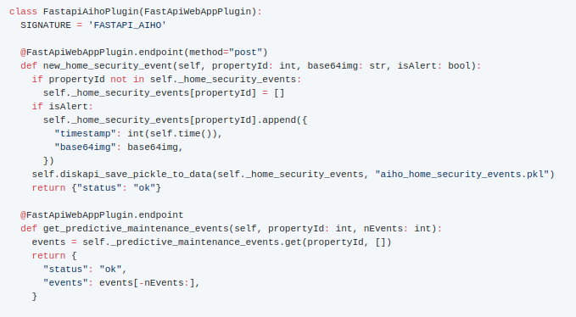
Sharing Results With AIHO (FastAPI Plugin)
We used small Python scripts to reproducibly spin up the pipelines on a node.
Integration note: this plugin is published through a Cloudflare tunnel so remote services access the endpoints without touching the node directly.

Slide 18
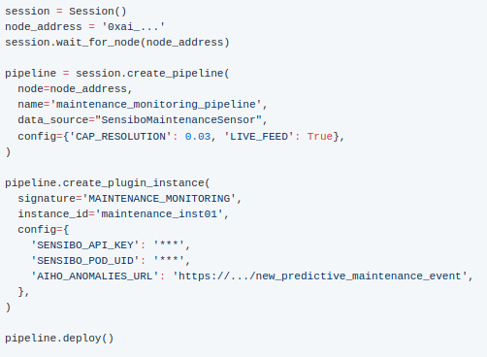
Deploying Everything With ratio1_sdk
We used small Python scripts to reproducibly spin up the pipelines on a node.
Swap credentials and URLs, run the script, and the node takes care of the rest.

Slide 19
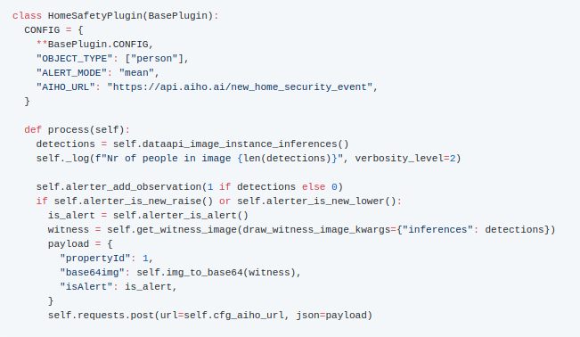
Home Safety Alerts (CV Plugin)
The home safety plugin sits downstream of an object detector and turns people detections into AIHO alerts.
What happens: the plugin monitors human presence over time, raises or clears alerts when thresholds are crossed, and ships a witness frame to AIHO.

Slide 20
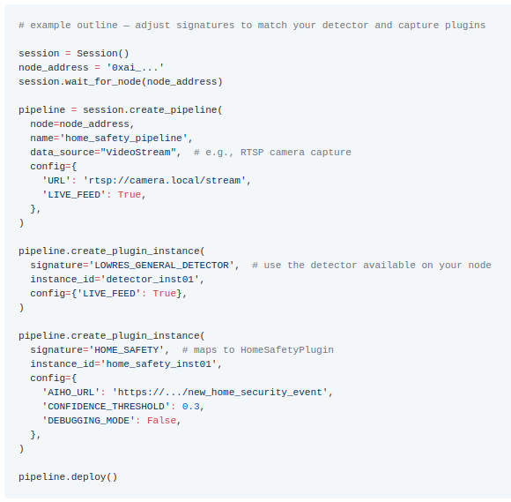
Home Safety Deployment
This wiring delivers people detections from the camera to the home safety plugin, which then synchronises alerts with AIHO.

Slide 21


Slide 22
Homework
Task 1 – Launch a Devnet Edge Node (see ratio1.ai/blog)
Task 2 – Deploy a Minimal FastAPI Backend
Build a FastAPI project exposing at least /health, /ping, and one custom analytics endpoint.
Use the sample script ratio1_sdk/tutorials/eth2025/deploy_fastapi_aiho.py as a template to deploy the service on the node (signature='FASTAPI_AIHO').
Enable the Cloudflare tunnel so the endpoints are publicly reachable; capture the tunnel URL for grading.
Task 3 – Deploy a Worker App Runner UI
Scaffold a lightweight web UI (React, Vue, or plain HTML/JS) that calls the FastAPI endpoints created in Task 2.
Adapt ratio1_sdk/tutorials/eth2025/deploy_fastapi_aiho_worker_app.py to configure a Worker App Runner pointing at the UI repository; make sure the build commands run a static bundle or dev server.
Verify that pushing a commit to the UI repository triggers an automatic rebuild (check the worker logs).
Deliverables
Node address and tunnel URL, shared in a short README.
GitHub repositories (or archives) for the FastAPI backend and the UI worker project.

Slide 23
References
[1] Cristian Bleotiu, Stefan Saraev, Bogdan Hobeanu, and Andrei Ionut Damian. Naeural ai os – decentralized ubiquitous computing mlops execution engine. https://arxiv.org/abs/2306.08708, 2025.
[2] Andrei Damian, Petrica Butusina, Alessandro De Franceschi, Vitalii Toderian, Marius Grigoras, Cristian Bleotiu Ratio1 Whitepaper https://arxiv.org/abs/2509.12223
[3] Andrei Ionut Damian, Cristian Bleotiu,Marius Grigoras, Petrica Butusina,Alessandro De-Franceschi, Vitalii Toderian and Nicolae Tapus. Ratio1 meta-OS - decentralized MLOps and beyond
[4] Ratio1 GitHub Repository https://github.com/
[4] Uwe Hansmann, Lothar Merk, Martin S Nicklous, and Thomas Stober. Pervasive computing: The mobile world. Springer Science & Business Media, 2003.
[5] Marco Conti, Sajal K Das, Chatschik Bisdikian, Mohan Kumar, Lionel MNi, Andrea Passarella, George Roussos, Gerhard Tröster, Gene Tsudik, and Franco Zambonelli. Looking ahead in pervasive computing: Challenges and opportunities in the era of cyber–physical convergence. Pervasive and mobile computing, 8(1):2–21, 2012.
[6] Uwe Hansmann, Lothar Merk, Martin S Nicklous, and Thomas Stober. Pervasive computing handbook. Springer Science & Business Media, 2013.
[7] S Chan. Fog brings the cloud closer to the ground: Cisco innovates in fog computing. URL: https://newsroom.cisco.com/featurecontent, 2017.
[6] Shermin Voshmgir. What is the token economy? O’Reilly Media, Incorporated, 2019

Slide 24
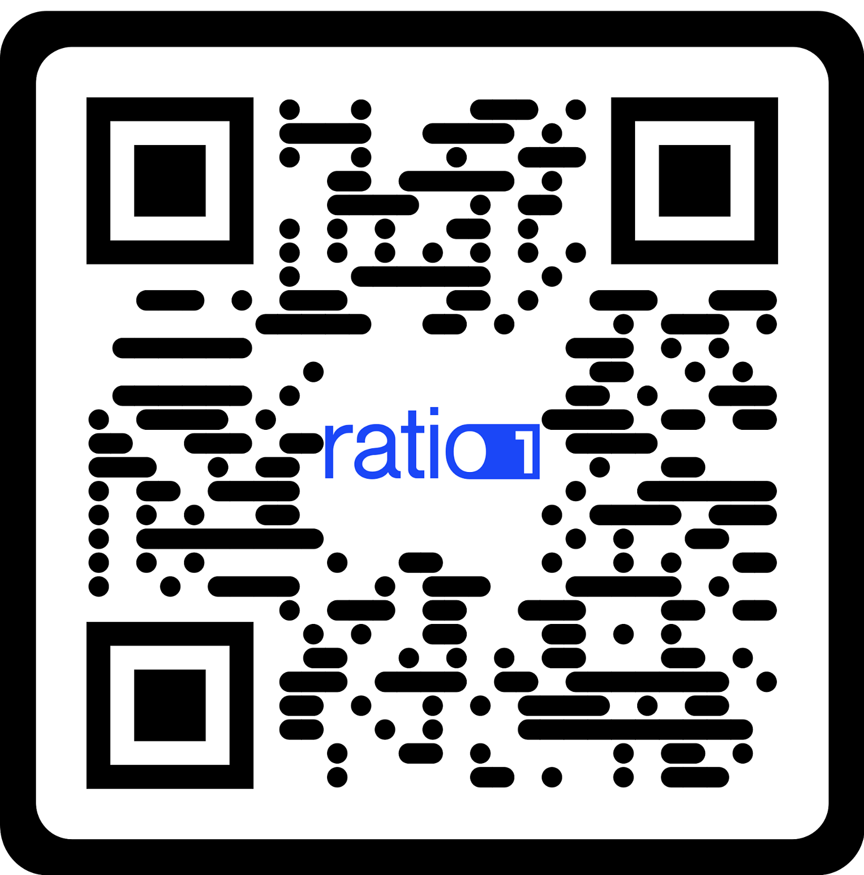
Thank you!
Notes:
I’m more than happy to answer any questions you might have.

